Slide 1
Python Basics
Vijayalakshmi G M

Slide 2
Python Basics - Topics
Introduction
Variable and Datatype
Input / Output
Expressions and Operator
Conditional Statement
Looping Statements
Function

Slide 3
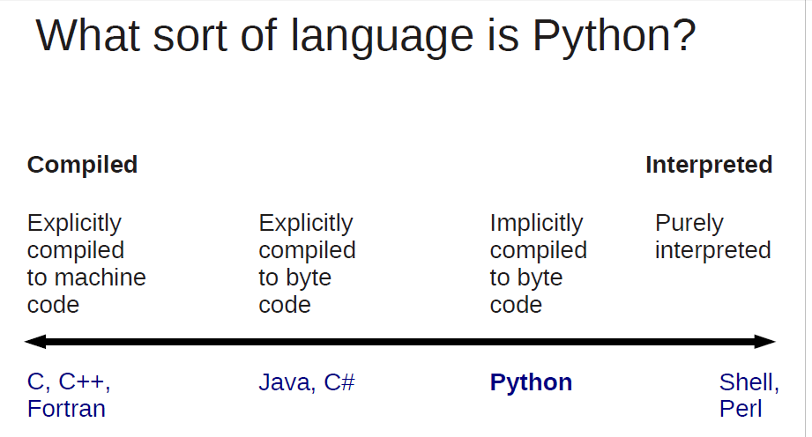
Introduction
Python is an interpreted, object-oriented, high-level general purpose programming language which supports Dynamic typing

Slide 4
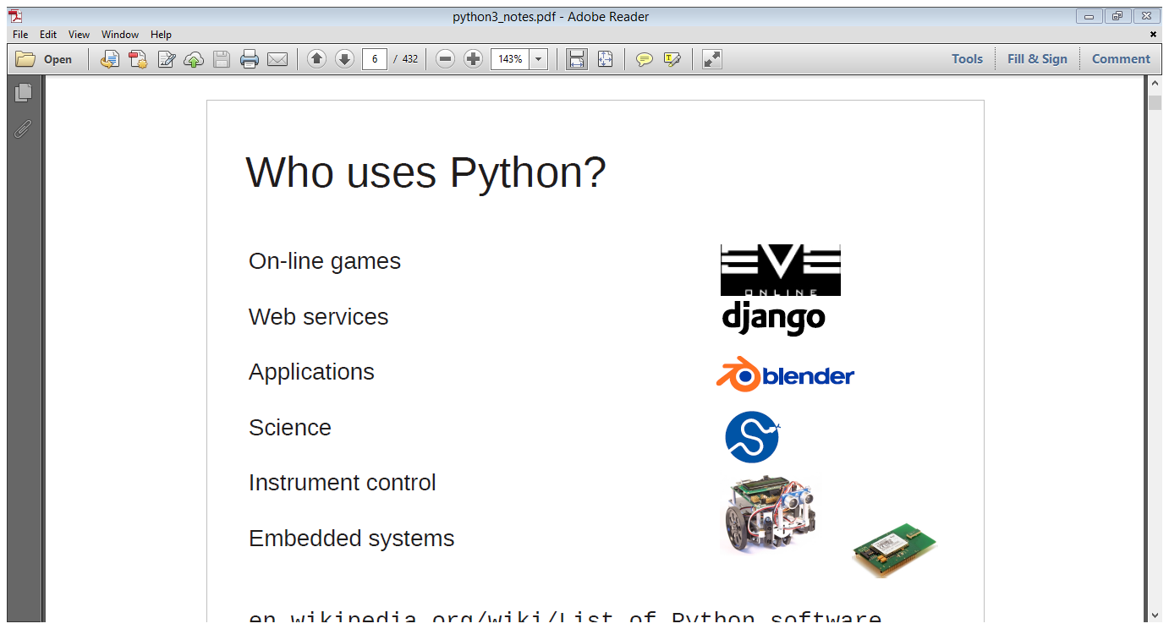
Python – Strengths and Users
Highly Interpreted – saves the compilation time
Code Readability
Popularity and community Support [ Google has developed several open source projects using python]

Slide 5
Python Version
2.x
2.7 is the last version
3.x
3.7 is the current version

Slide 6
Python Installation
Python can be installed on Linux, Windows and Mac
Download from https://www.python.org/downloads/
Follow the Instruction and Install the python.

Slide 7
First Python Program
Type the Program in the Python IDLE
# First Python program
print (“Hello World”)
# Comment in the Python
print() is used to print the output.

Slide 8
Variable and Datatype
Reserved Memory Location used for storing the values
Explicit variable declaration is not required
Variable will be declared automatically when you assign the value to the variable
Example:
Empno=2004
Empname=”Sanjay”

Slide 9
Variable and Datatype
Variable Naming Convention
The start character can be the underscore "_" or a capital or lower case letter.
The letters following the start character can be anything which is permitted as a start character plus the digits.
Just a warning for Windows-spoilt users: Identifiers are case-sensitive!
Python keywords are not allowed as identifier names!

Slide 10
Variable and Datatype
Datatype indicates the type of value to be stored in the variable.
Python supports
Basic Data types – int, str, float and bool
Complex Data types – list, tuple and dictionary

Slide 11
Basic Input / Output in Python
input() function – to accept the input value from the user
print() function – to print the output

Slide 12
Basic Input / Output in Python
input() function – to accept the input value from the user
print() function – to print the output

Slide 13
Python Conditional Statements
if elif else statement
if <condition> :
<statements>
elif <condition> :
<statements>
else :
<statements>

Slide 14
Python Conditional Statements
if statement
if <condition> :
<statements>
if else statement
if <condition> :
<statements>
else :
<statements>

Slide 15
Looping Statements
while loop
while <condition>
<statement>
for loop
for <variablename> in <Group of value>:
<statement>

Slide 16
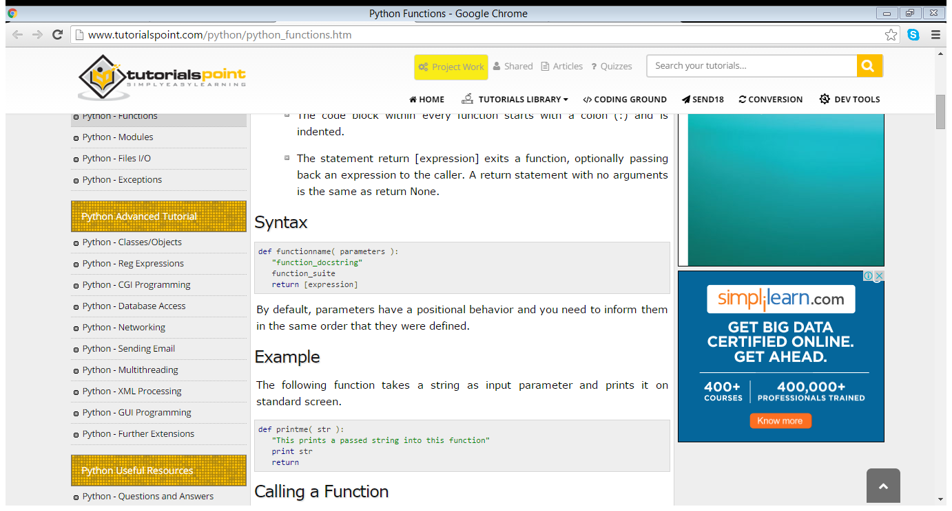
Python Function
Function is a type of subprogram to perform the specific task.
“def” keyword is used to define the function
Syntax:

